Slide 1
Computer Architecture Experiment
Topic 1. Single-cycle CPU Design
浙江大学计算机学院
陈文智
chenwz@zju.edu.cn

Slide 2
实验操作流程
阅读实验文档，理解单周期处理器的各个功能模块组成和内部实现方式。
补全各个功能模块源代码中的空缺部分。
对处理器进行仿真，检验处理器的仿真结果是否符合要求。
综合工程并下载至开发板，在单步执行的过程中检查调试屏幕的输出，检验处理器的执行过程是否正确。

Slide 3
实验验收标准
仿真执行过程中，处理器的行为和内部控制信号均符合要求。
下载至开发板后的单步执行过程中，寄存器的变化过程和最终执行结果与测试程序相吻合。

Slide 4
Outline
Experiment Purpose
Experiment Task
Basic Principle
Operating Procedures
Precaution
Checkpoints

Slide 5
Experiment Purpose
Understand the principles of single-cycle CPU controller and master methods of single-cycle CPU controller design
Understand the principles of datapath and master methods of datapath design
Understand the principles of single-cycle CPU and master methods of single-cycle CPU design
master methods of program verification of CPU

Slide 6
Experiment Task
Design the CPU Controller, Datapath, bring together the basic units into Single-cycle CPU
Verify the Single-Cycle CPU with program and observe the execution of program

Slide 7
16 MIPS Instructions
Bit # | 31..26 | 25..21 | 20..16 | 15..11 | 10..6 | 5..0 | Operations
R-type | op | rs | rt | rd | sa | func
add | 000000 | rs | rt | rd | 00000 | 100000 | rd = rs + rt; with overflow | PC+=4
sub |  | rs | rt | rd | 00000 | 100010 | rd = rs - rt; with overflow | PC+=4
and |  | rs | rt | rd | 00000 | 100100 | rd = rs & rt; | PC+=4
or |  | rs | rt | rd | 00000 | 100101 | rd = rs | rt; | PC+=4
sll |  | 00000 | rt | rd | sa | 000000 | rd = rt << sa; | PC+=4
srl |  | 00000 | rt | rd | sa | 000010 | rd = rt >> sa (logical); | PC+=4
slt |  | rs | rt | rd | 00000 | 101010 | if(rs < rt)rd = 1; else rd = 0; <(signed) | PC+=4
jr |  | rs | 00000 | 00000 | 00000 | 001000 |  | PC=rs
I-type | op | rs | rt | immediate
addi | 001000 | rs | rt | imm |  |  | rt = rs + (sign_extend)imm; with overflow | PC+=4
andi | 001100 | rs | rt | imm |  |  | rt = rs & (zero_extend)imm; | PC+=4
ori | 001101 | rs | rt | imm |  |  | rt = rs | (zero_extend)imm; | PC+=4
lw | 100011 | rs | rt | imm |  |  | rt = memory[rs + (sign_extend)imm]; | PC+=4
sw | 101011 | rs | rt | imm |  |  | memory[rs + (sign_extend)imm] <-- rt; | PC+=4
beq | 000100 | rs | rt | imm |  |  | if (rs == rt) PC+=4 + (sign_extend)imm <<2; | PC+=4
J-type | op | address
j | 000010 | address |  |  |  |  | PC = (PC+4)[31..28],address<<2
jal | 000011 | address |  |  |  |  | PC = (PC+4)[31..28],address<<2 ; $31 = PC+4

Slide 8
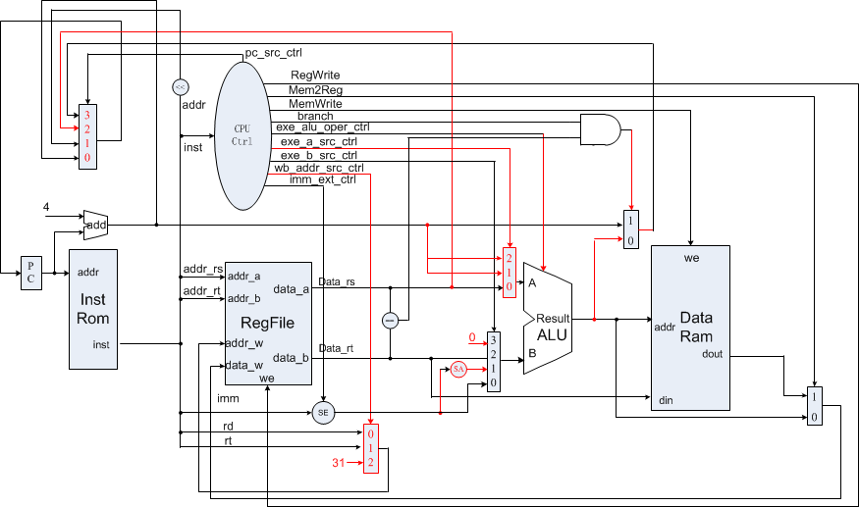
CPU Controller

Slide 9
Output of CPU Controller(1)
pc_src_ctrl(inst_addr)
Default: PC+4
PC_JUMP: {inst_addr[31:28], inst_data[25:0], 2'b0}
PC_JR: data_rs
PC_BEQ: alu_out
wb_addr_src_ctrl (regw_addr)
WB_ADDR_RD: addr_rd
WB_ADDR_RT: addr_rt
WB_ADDR_LINK: GPR_RA

Slide 10
Output of CPU Controller(2)
exe_a_src_ctrl(opa)
EXE_A_RS: data_rs
EXE_A_LINK: inst_addr_next
EXE_A_BRANCH: inst_addr_next
exe_b_src_ctrl(opb)
EXE_B_RT: data_rt
EXE_B_IMM: data_imm
EXE_B_LINK: 32'h0
EXE_B_BRANCH: {data_imm[29:0], 2'b0}

Slide 11
Datapath

Slide 12
Basic Units of Single-cycle CPU
CPU Controller
ALU
Register file
Instruction Mem. and Data Mem.
others：Register, sign-extend Unit, shifter, multiplexer

Slide 13
Instruction Memory
parameter
ADDR_WIDTH = 6;
reg [31:0] data [0:(1<<ADDR_WIDTH)-1];
initial begin
$readmemh("inst_mem.hex", data);
end
always @(*) begin
if (addr[31:ADDR_WIDTH] != 0)
dout = 32'h0;
else
dout = data[addr[ADDR_WIDTH-1:0]];
end

Slide 14
Data Memory(1)
parameter
ADDR_WIDTH = 5;
reg [31:0] data [0:(1<<ADDR_WIDTH)-1];
initial begin
$readmemh("data_mem.hex", data);
end
always @(negedge clk) begin
if (we && addr[31:ADDR_WIDTH]==0)
data[addr[ADDR_WIDTH-1:0]] <= din;
end

Slide 15
Data Memory(2)
reg [31:0] out;
always @(negedge clk) begin
out <= data[addr[ADDR_WIDTH-1:0]];
end
always @(*) begin
if (addr[31:ADDR_WIDTH] != 0)
dout = 32'h0;
else
dout = out;
end

Slide 16
Register File
reg [31:0] regfile [1:31]; // $zero is always zero
// write
always @(posedge clk) begin
if (en_w && addr_w != 0)
regfile[addr_w] <= data_w;
end
// read
always @(*) begin
data_a = addr_a == 0 ? 0 : regfile[addr_a];
data_b = addr_b == 0 ? 0 : regfile[addr_b];
end
// debug
`ifdef DEBUG
always @(*) begin
debug_data = debug_addr == 0 ? 0 : regfile[debug_addr];
end
`endif

Slide 17
Timing for single-cycle
Instruction Mem. Read: anytime
Regfile Read: anytime
Data Mem. Read/Write: Negtive Edge
Regfile Write: Positive Edge

Slide 18
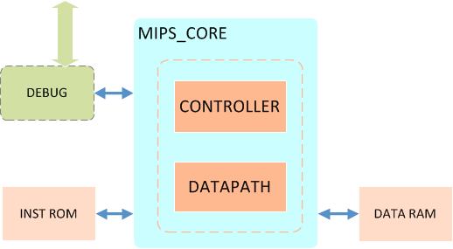
SC CPU Diagram

Slide 19
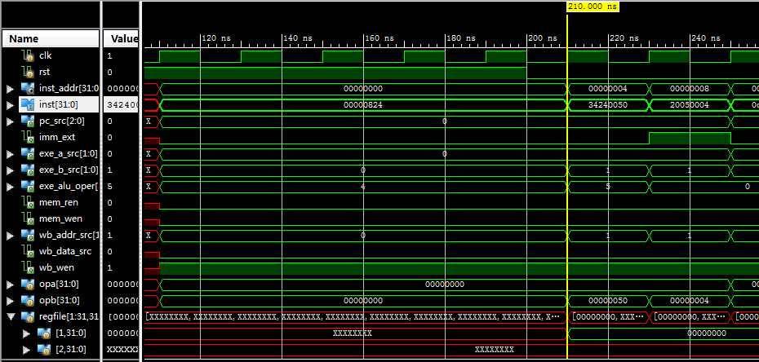
Simulation (1)

Slide 20
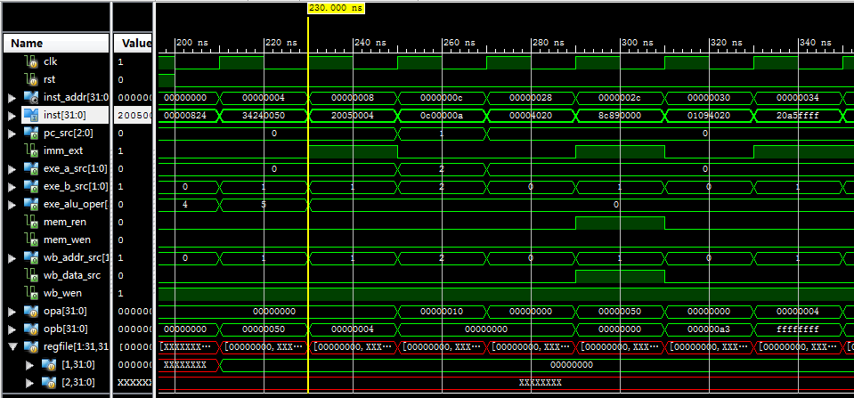
Simulation (2)

Slide 21
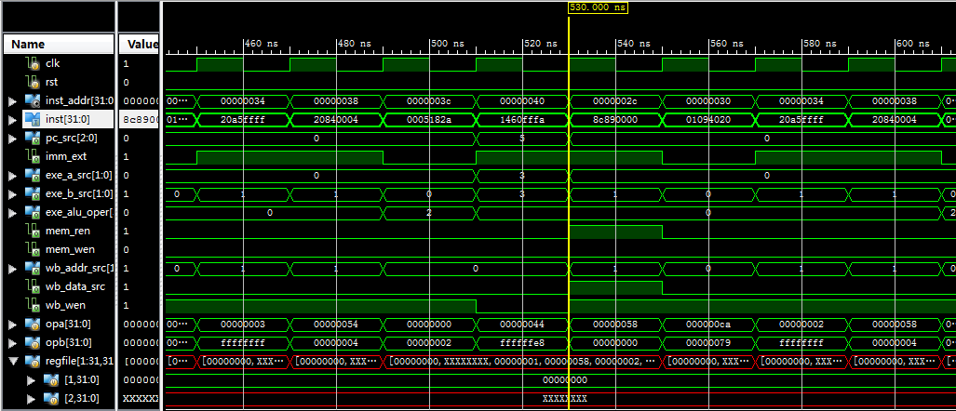
Simulation (3)

Slide 22
Program for verification (1)
00000824 main: and $1, $0, $0 # address of data[0]
34240050 ori $4, $1, 80 # address of data[0]
20050004 call: addi $5, $0, 4 # counter
0c00000a jal sum # call function
ac820000 return: sw $2, 0($4) # store result
8c890000 lw $9, 0($4) # check sw
ac890004 sw $9, 4($4) # store result again
01244022 sub $8, $9, $4 # sub: $8 <- $9 - $4
08000008 finish: j finish # dead loop
00000000 nop # done

Slide 23
Program for verification (2)
00004020 sum: add $8, $0, $0 # sum function entry
8c890000 loop: lw $9, 0($4) # load data
01094020 add $8, $8, $9 # sum
20a5ffff addi $5, $5, -1 # counter - 1
20840004 addi $4, $4, 4 # address + 4
0005182a slt $3, $0, $5 # finish?
1460fffa bne $3, $0, loop # finish?
01001025 or $2, $8, $0 # move result to $v0
03e00008 jr $ra # return
00000000 nop # done

Slide 24
Checkpoints
CP 1: Waveform Simulation of Single-cycle CPU
CP 2: FPGA Implementation of Single-cycle CPU with the verification program

Slide 25
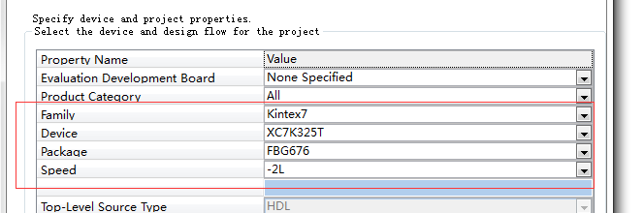
FPGA Implementation
Project Settings
Top Module: mips_top

Slide 26
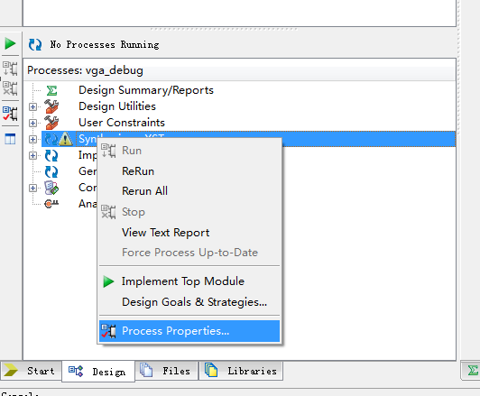
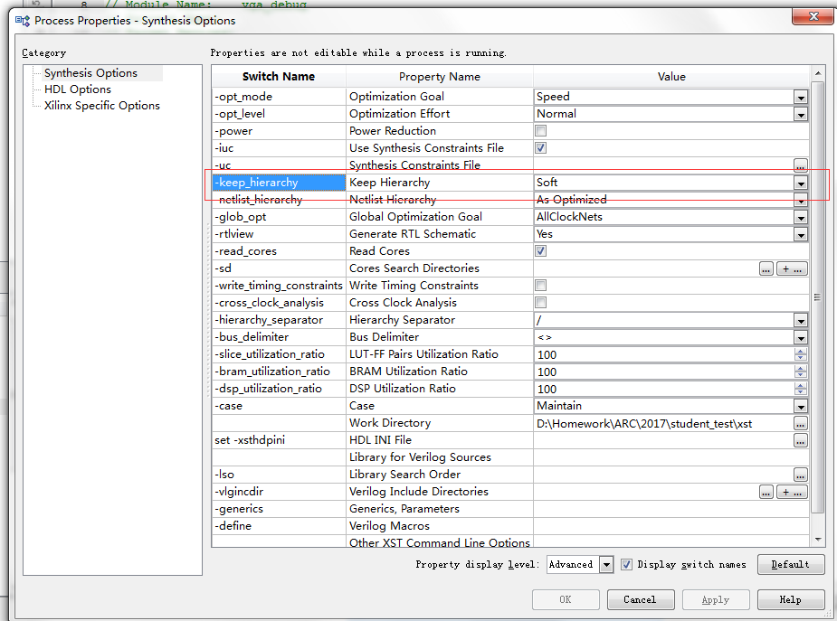
FPGA Implementation

Slide 27
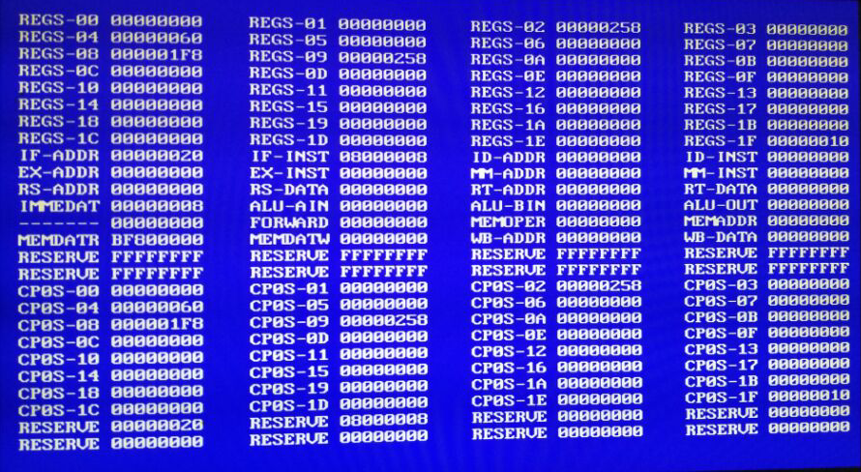
FPGA Implementation
VGA-based debugger

Slide 28
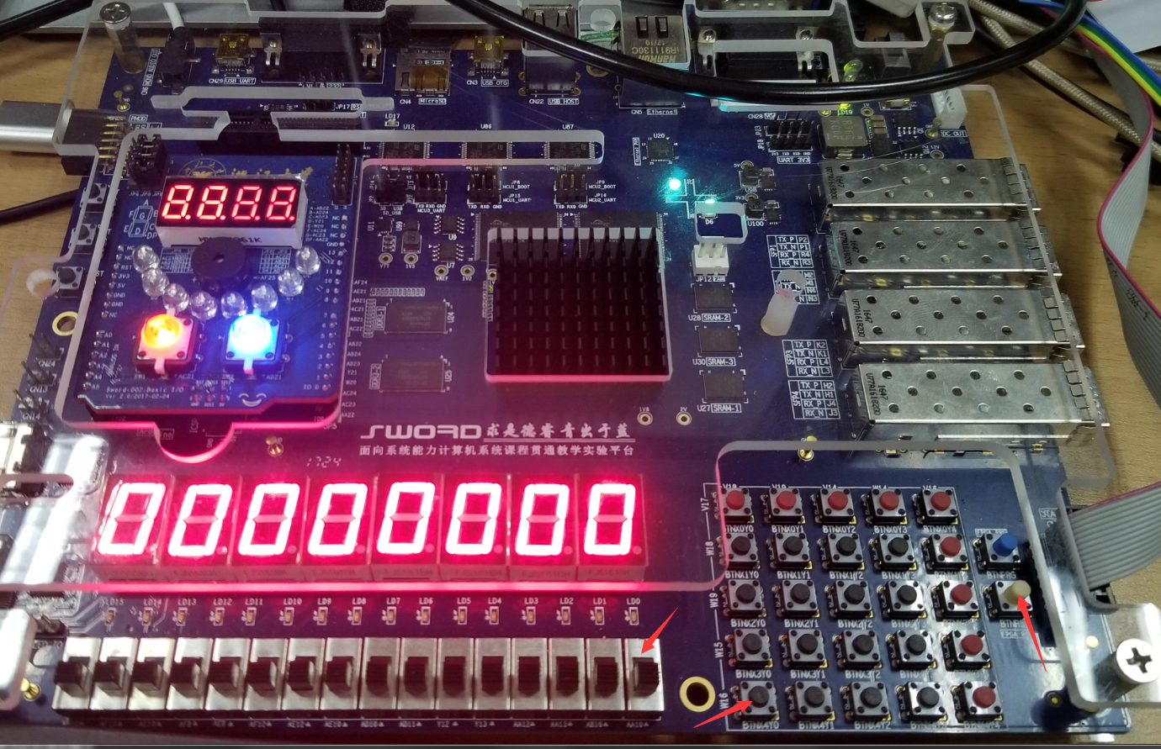
FPGA Implementation
Control
Enable Single Step: SW[0]
Step: BTNX4Y0
Reset: BTNRST

Slide 29
Thanks!

